Slide 1

High Cloud Airline Analytics
BATCH-04
Revathi
Vaishanvi
Vikas
Siva Rama Krishna
Sagar
Nagendra

Slide 2
Overview
The High Cloud Airline Analytics project analyzes airline performance using tools like Excel, Power BI, SQL, and Tableau. Key metrics include the number of airlines, total airtime, distance covered, passenger count, and load factor percentages. The project focuses on identifying trends in flight operations, passenger preferences, and carrier performance. The goal is to create interactive dashboards and provide data-driven insights to improve airline efficiency and customer satisfaction.

Slide 3

Tools Used
Microsoft Excel
Microsoft Power BI
Tableau
MYSQL

Slide 4
Project Workflow
Extract data/import data
Transform data(Remove blank and duplicates)
Manage Relationships
KPI and Visualization
Dashboard

Slide 5

Main KPI’s
Load factor Percentage on a Yearly, Quarterly and Monthly basis
Load factor Percentage based on Carrier name
Top 10 Carrier names based on passengers preference
Top routes(from-to-city) based on Number of Flights
Load Factor Percentage on Weekend vs weekdays
Number of flights based on Distance Groups

Slide 6
Challenges Faced
Data Import Issues: Facing problems with inconsistent formatting while moving data between Excel, Tableau, Power BI, and SQL.
Data Cleaning: Fixing missing or incomplete data, especially for important metrics like passenger counts and load factors.
Tool Integration: Ensuring the data stays consistent and accurate across all tools during analysis.
Visualization Optimization: Making dashboards that are both visually appealing and easy to understand.
Performance Issues: Large amounts of data caused slow SQL queries and delayed dashboard updates.

Slide 7
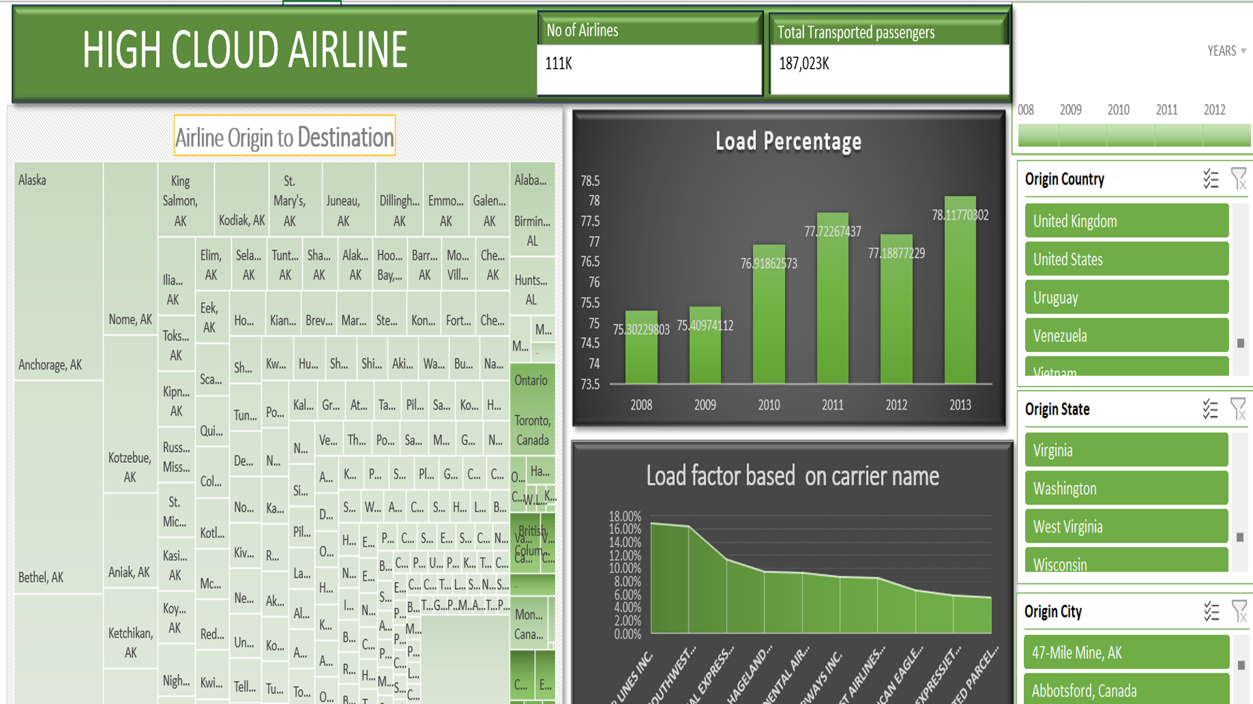
Excel Dashboard

Slide 8
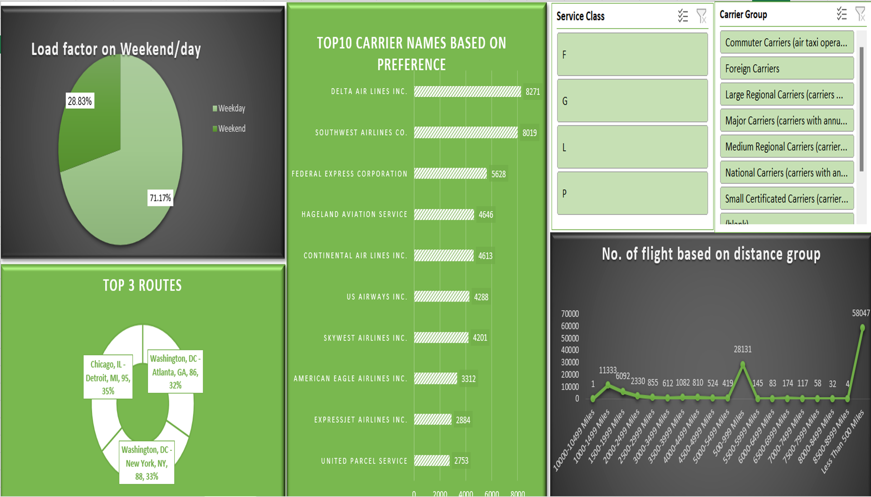
Excel Dashboard

Slide 9
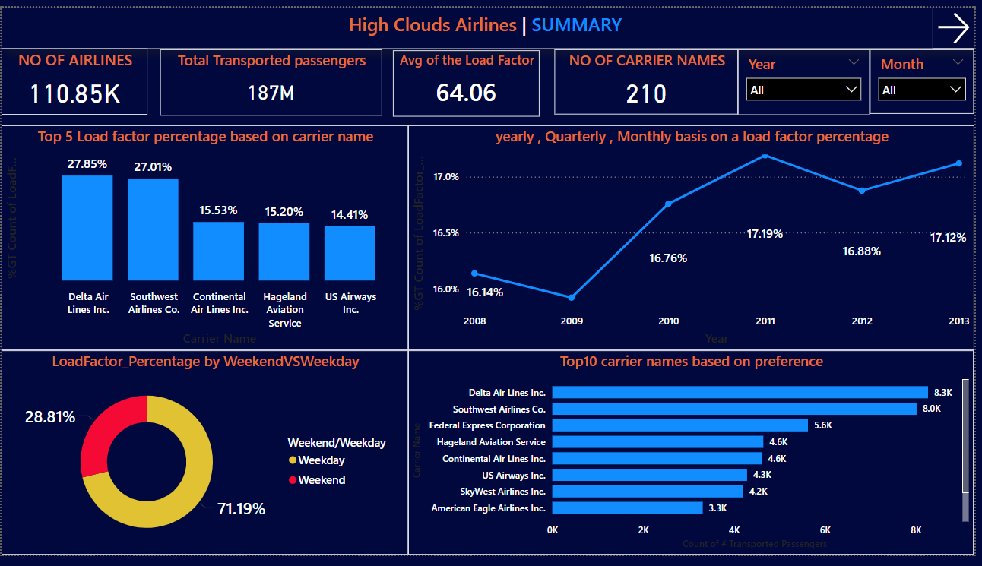
Power BI Dashboard

Slide 10
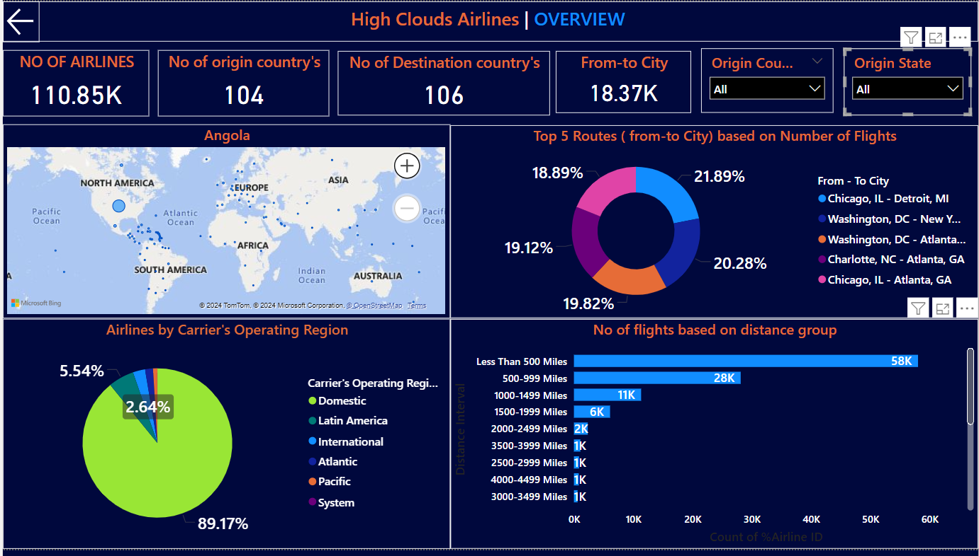
Power BI Dashboard

Slide 11
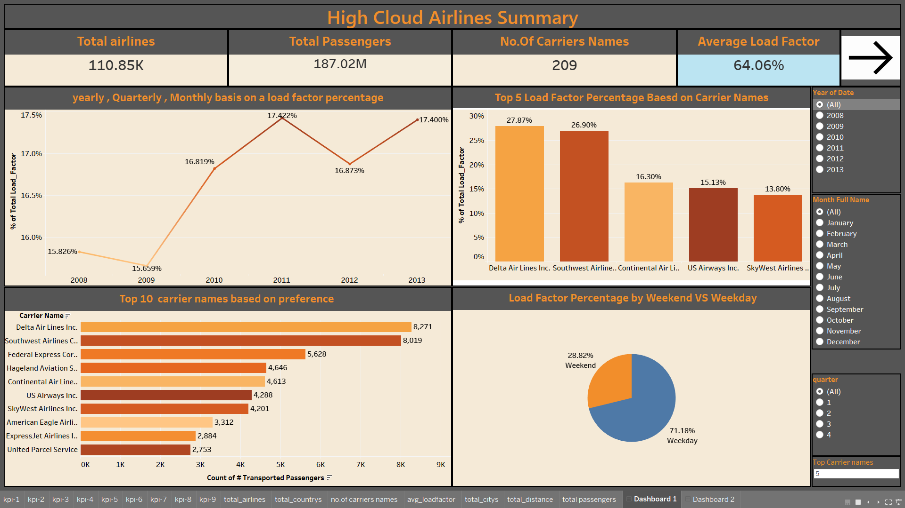
Tableau Dashboard

Slide 12
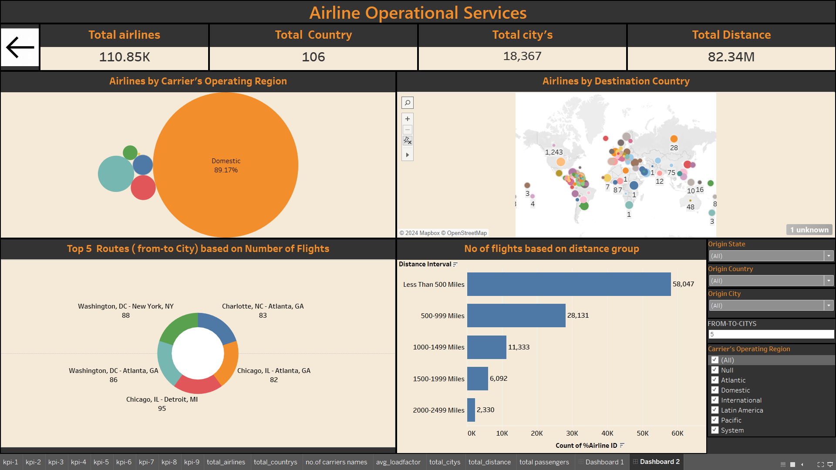
Tableau Dashboard

Slide 13
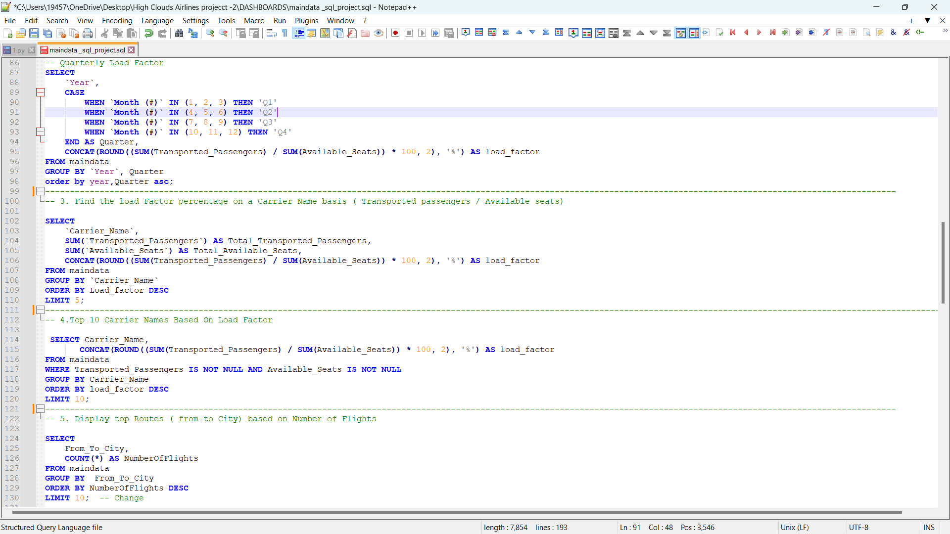
SQL

Slide 14
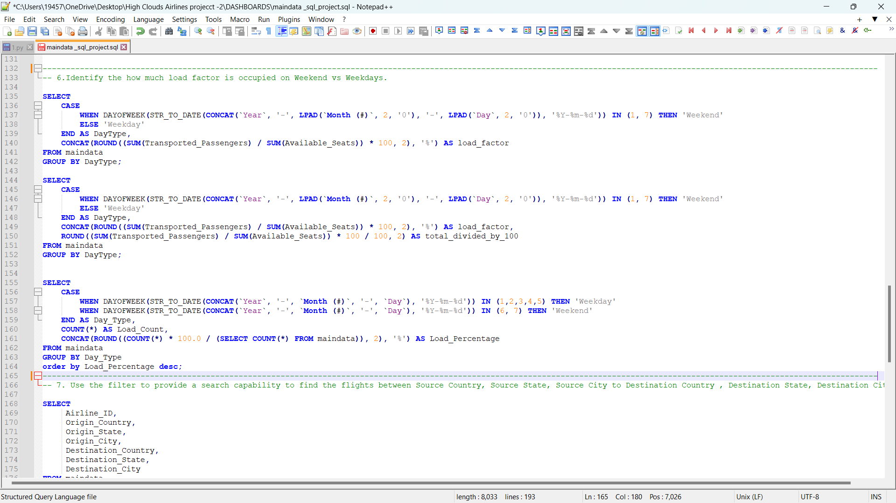
SQL

Slide 15
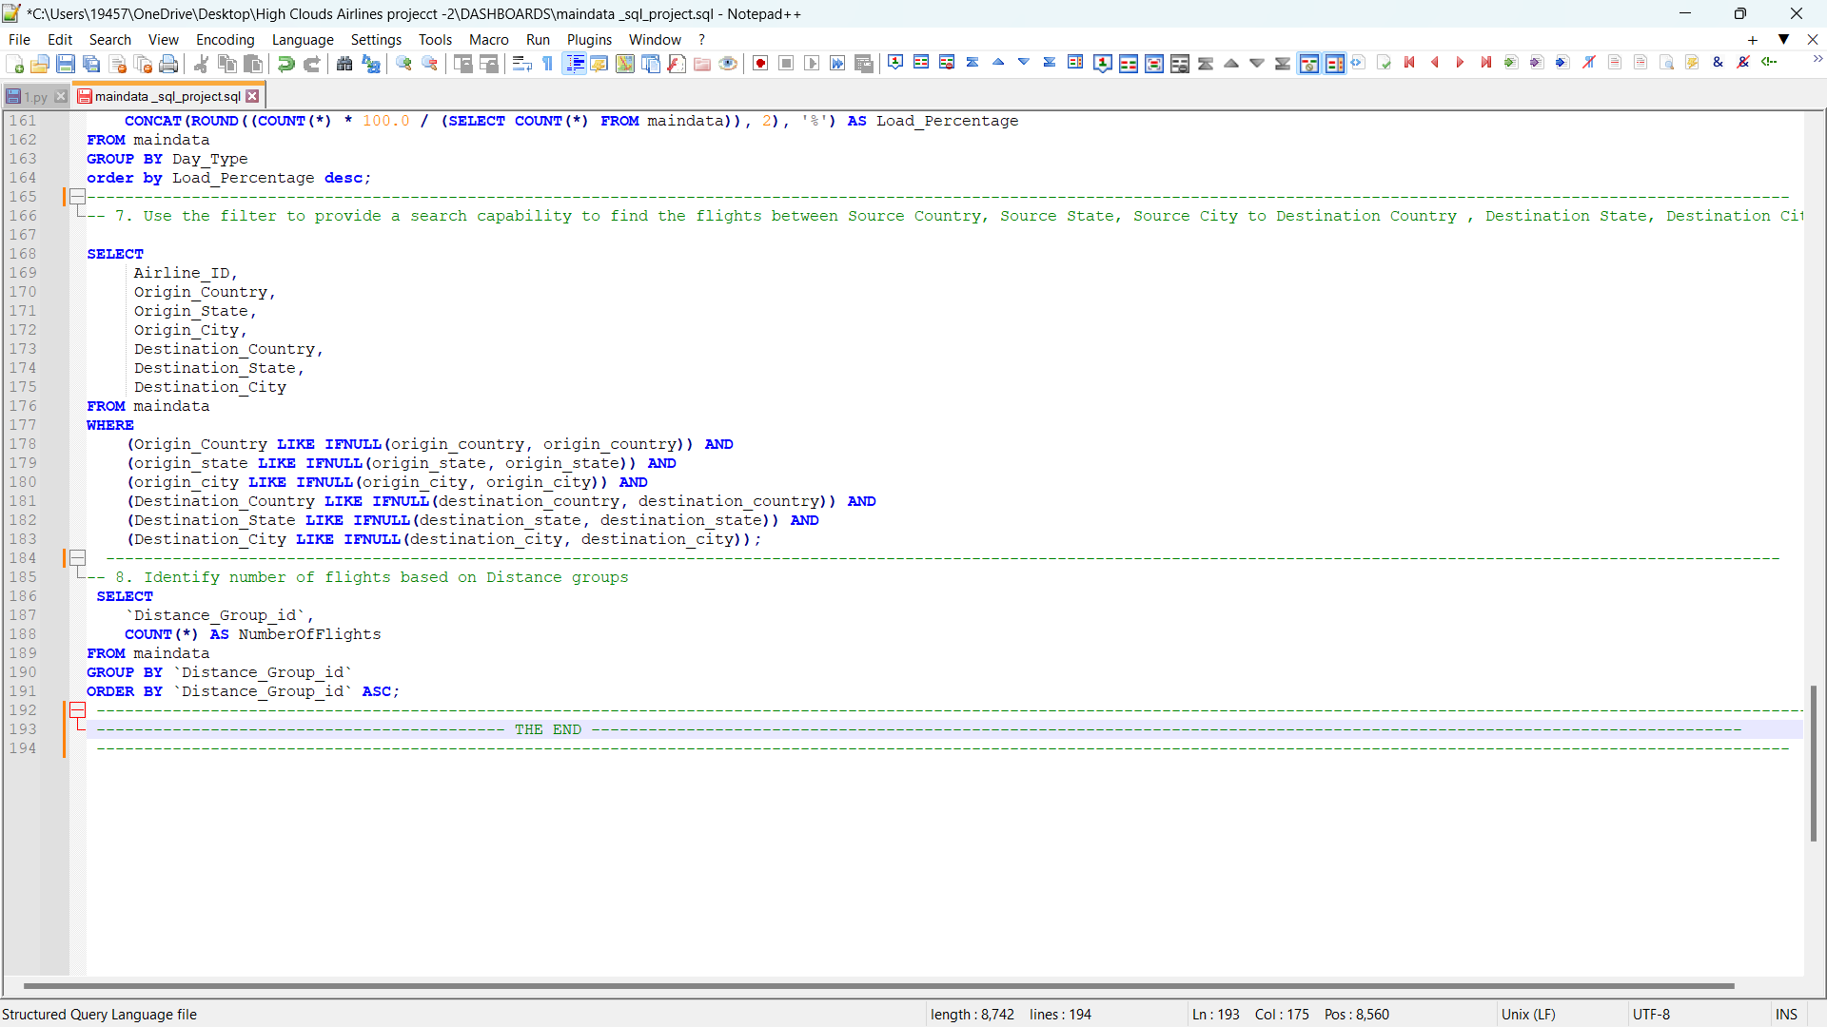
SQL

Slide 16
Insights
Yearly Trends: Load factors showed a steady improvement over the years, with notable increases during specific periods.
Passenger Preferences: Weekend flights were less popular compared to weekday flights.
Top Routes: Washington, D.C.–Atlanta and Chicago–Detroit emerged as the most popular routes based on flight frequency.
Top Carriers: Delta Air Lines and FedEx were the top carriers based on passenger preferences.
Distance Group Segmentation: Flights in shorter distance groups have higher frequencies compared to longer ones.

Slide 17
Recommendations
Adjust Flight Schedules: Plan more flights during busy weekdays and for weekend we have to provide discounts and packages for passengers.
Improve Low-Performing Routes : Focus advertising on routes that are having low performing routes to attract new passengers.
Work with Top Airlines: Partner with successful airlines to offer more routes and better services for customers.
Use Smart Pricing: Set ticket prices based on demand to increase profits and fill more seats.
We found the load factor to be 71.19% on weekdays and 28.81% on weekends, suggesting increased airlines during weekends.
We found that approximately three airlines operate flights to Kuwait, and we suggest increasing the number of airlines serving this country to enhance connectivity and improve travel options.

Slide 18
Conclusion
The High Cloud Airline Analytics project delivers valuable insights into airline operations, passenger behavior, and carrier performance. By utilizing these data-driven insights, airlines can optimize operational efficiency, elevate the customer experience, and make strategic decisions that drive sustainable growth and long-term success.

Slide 19

THANK YOU

